Slide 1

Geographies of Poverty:
Improving the reliability and usability of spatial displays of small area data from the American Community Survey
Presented by:
Ben Horwitz
April 2, 2014
Notes:
As we know, much socio-economic data is available only from the ACS, which is subject to large margins of error. However, it is quite difficult to convey margins of error spatially. Therefore, with significant guidance from experts at Nielsen, the Data Center created and evaluated new methods to improve the ACS block group estimates for use in mapping.

Slide 2
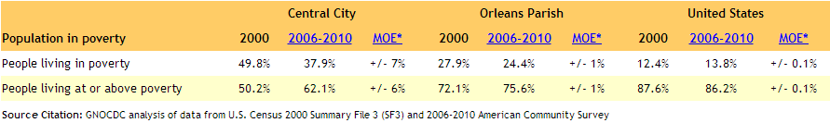
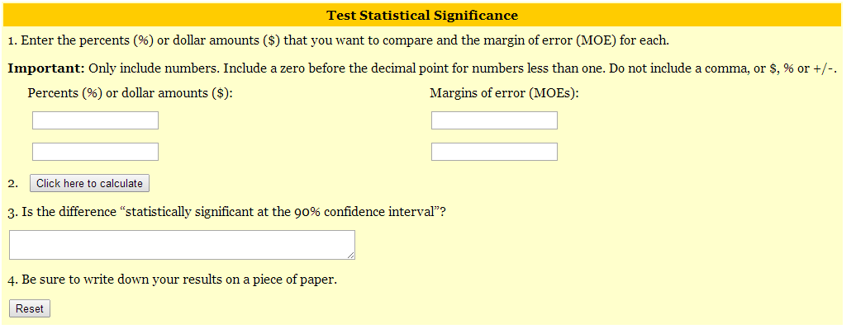
We already display the margin of error in our neighborhood profiles.
Central City Statistical Area, Neighborhood Statistical Area Data Profile
Notes:
We already display the margin of error in our neighborhood profile alongside the data point. And in fact, we also created a widget that helps user understand and write about the margin of error is and conduct statistical significance testing with instructions on how to write about the findings from the stat testing.

Slide 3
Another way to look at the margin of error is to explore the confidence interval.
Poverty rates and their 90% confidence interval by New Orleans neighborhood, 2006-2010
Source: The Data Center analysis of data from 2006-2010 American Community Survey
Notes:
Another way to look at the margin of error of course is to explore the confidence interval. When we look at the confidence interval of all of the neighborhoods and add the potential breakpoints to use in a map we find that many neighborhoods stretch across the potential classification schema.

Slide 4
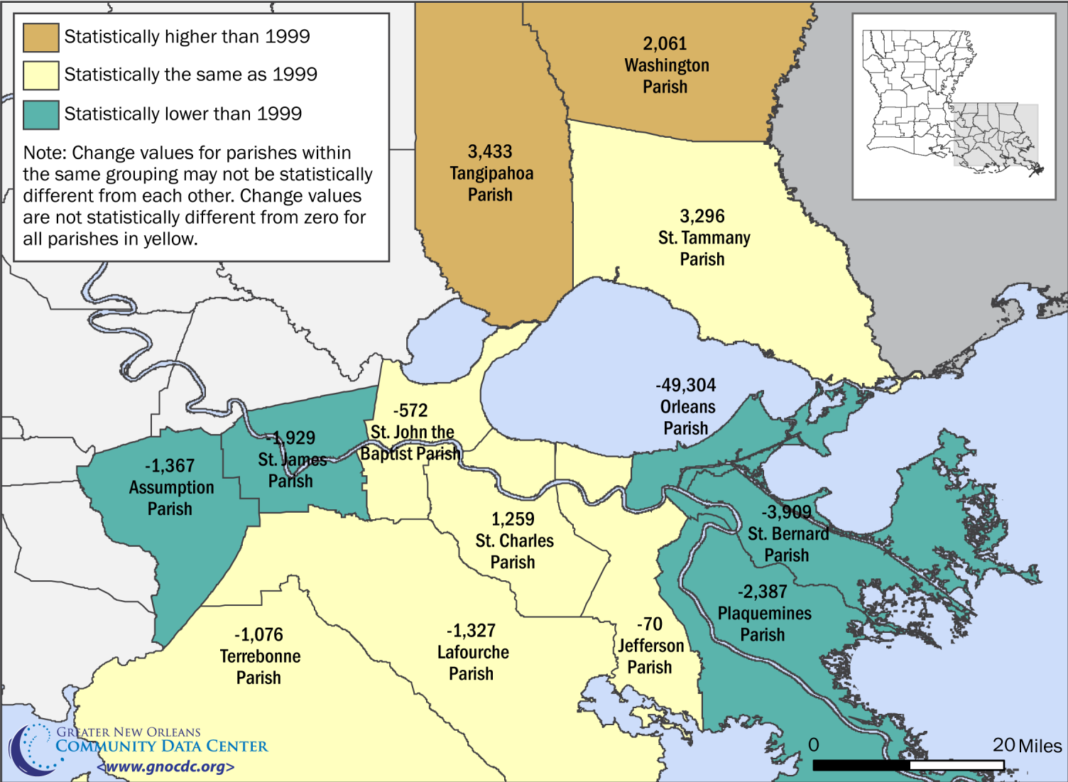
Researchers have produced several methods for mapping the margin of error.
Change in the population in poverty by parish, 1999 to 2008-10 (three-year average)
Source: Plyer, A. & Ortiz, E. (2012). Poverty in Southeast Louisiana post-Katrina. The Data Center.
Notes:
Researchers have produced several methods for mapping the margin of error. One method is to classify values as statistically higher or lower than a fixed value. However, we would lose the rich variation in the neighborhoods if we only looked to see if poverty is higher or lower than 1999 or than the city as a whole.

Slide 5
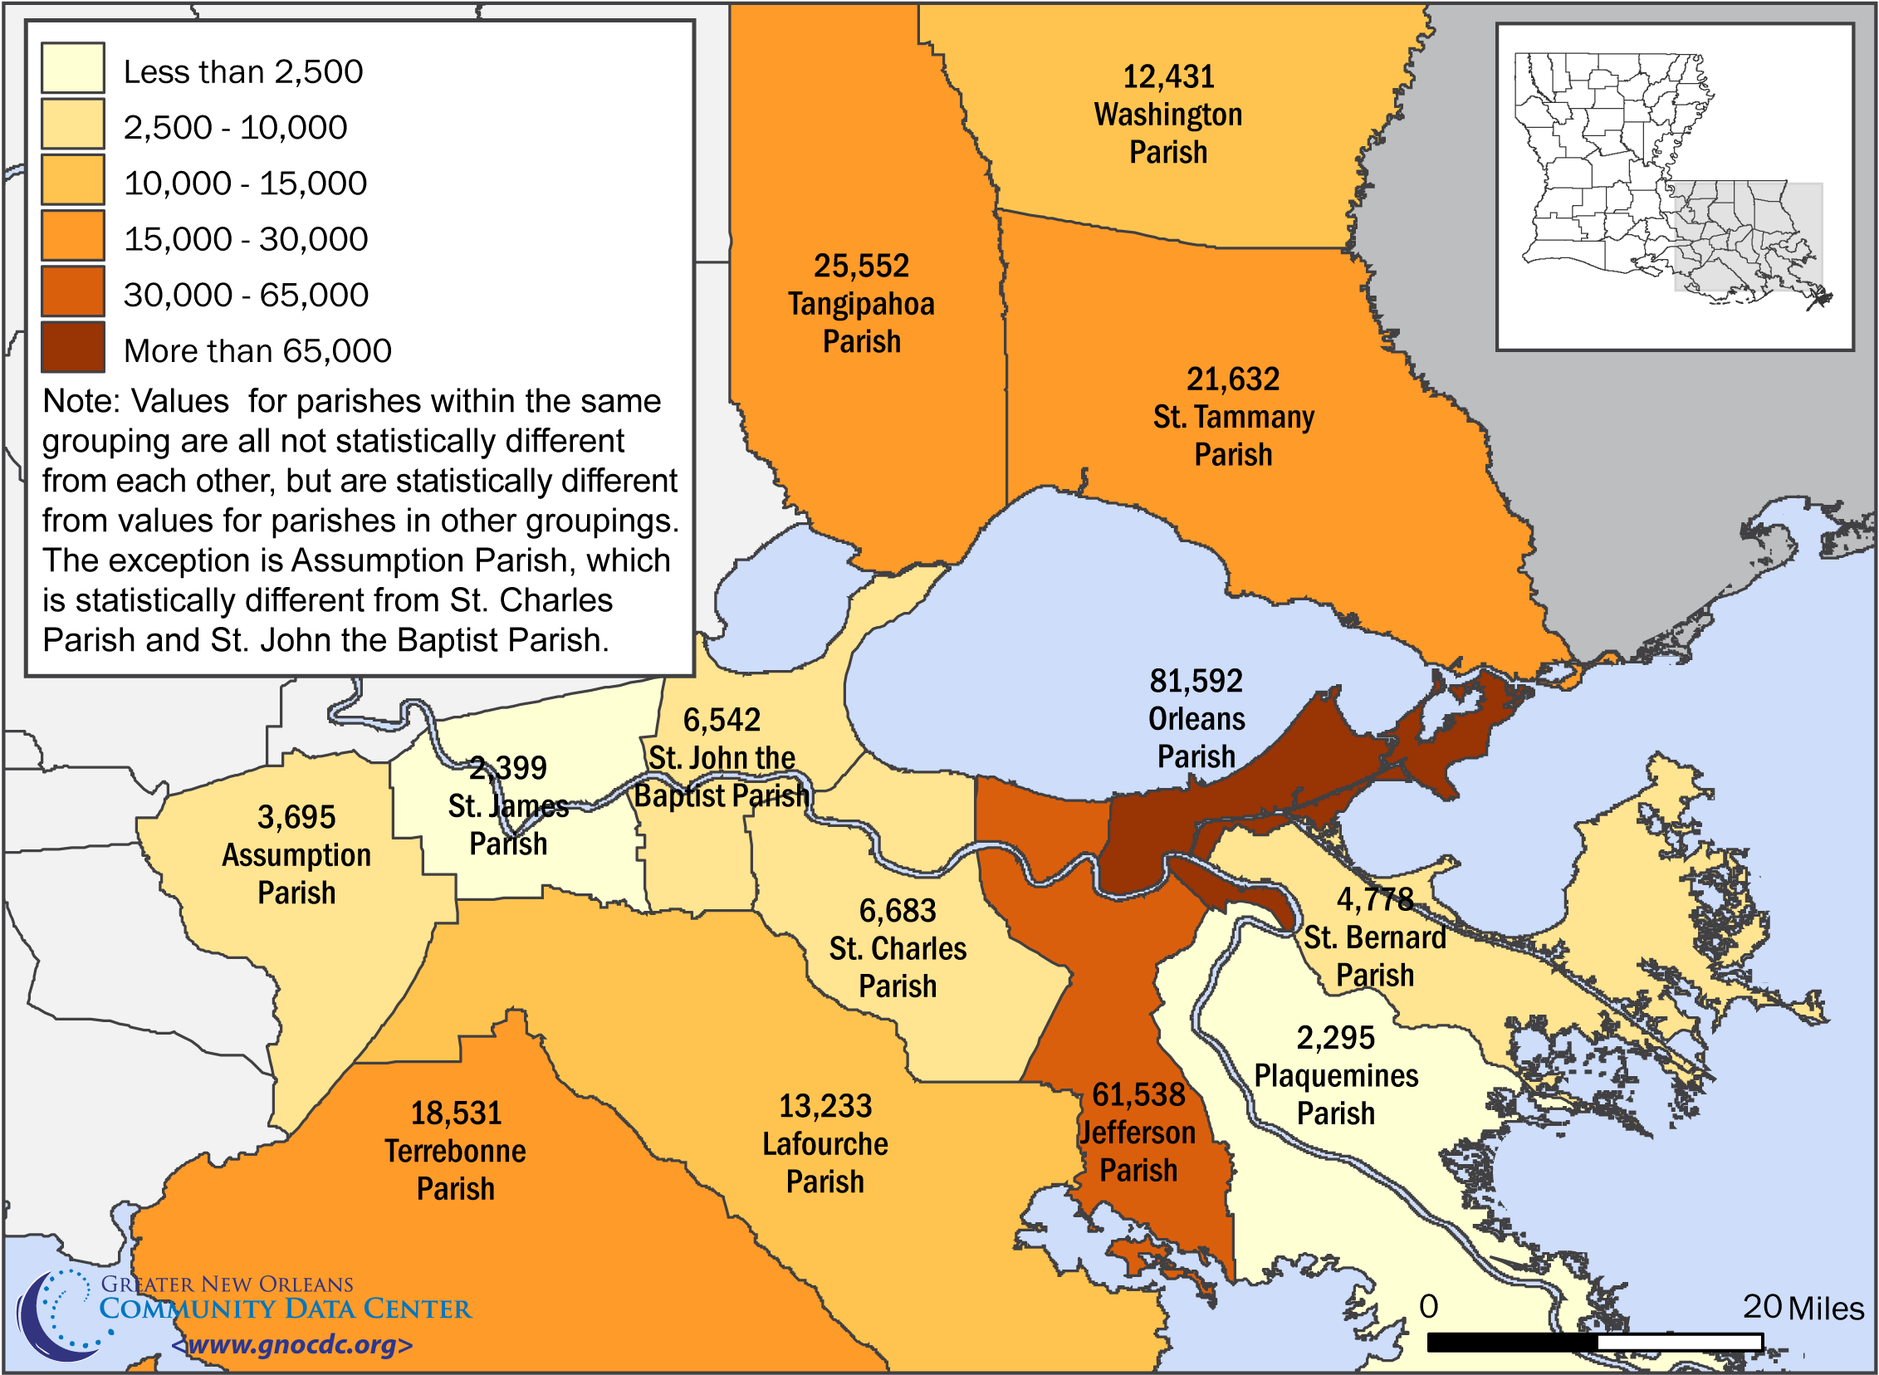
Researchers have produced several methods for mapping the margin of error.
Population in poverty by parish, 2008-10 (three-year average)
Source: Plyer, A. & Ortiz, E. (2012). Poverty in Southeast Louisiana post-Katrina. The Data Center.
Notes:
Another mapping technique involves creating fixed categories in which all values within each category are statistically different from all values in other categories. This works when there are a limited number of geographies to compare. However, as the number of geographies increases, the possibility of finding distinct categories decreases.

Slide 6
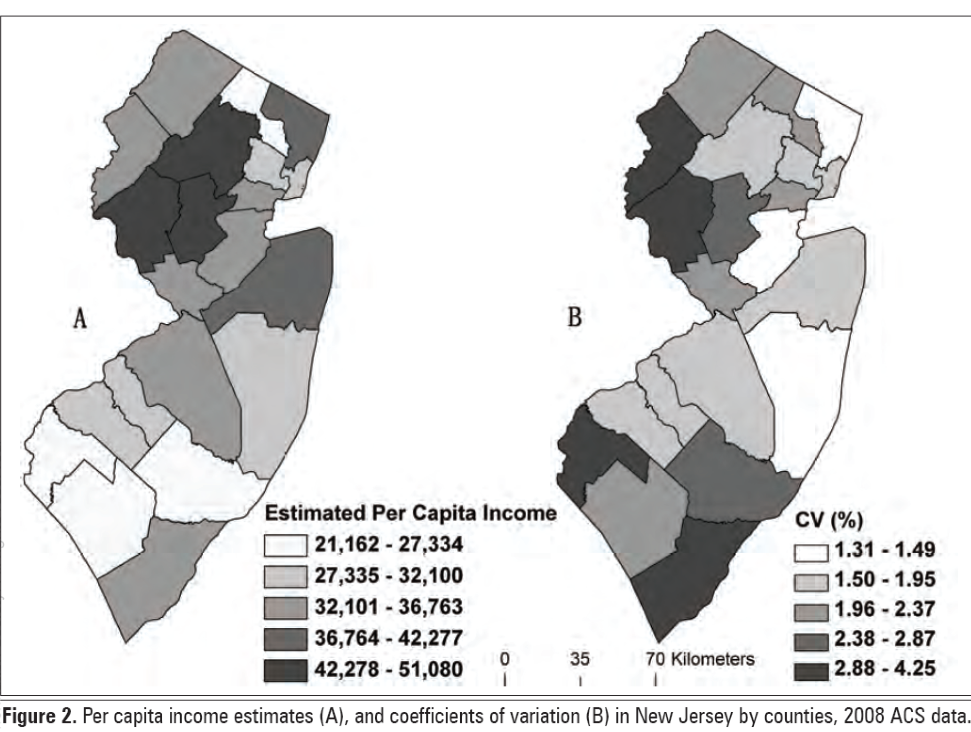
Researchers have produced several methods for mapping the margin of error.
Example side-by-side maps.
Source: Sun, M. and D. W. S. Wong. (2010). Incorporating data quality information in mapping the American Community Survey data.
Cartography and Geographic Information Science 37 (4): 285-300.
Notes:
A third option is to show two maps side-by-side with the first map showing the values and the second map showing the margin of error. The drawback of this option is that it is difficult for users to quickly and easily understand the maps when they have to switch between the two in order to determine reliability.

Slide 7
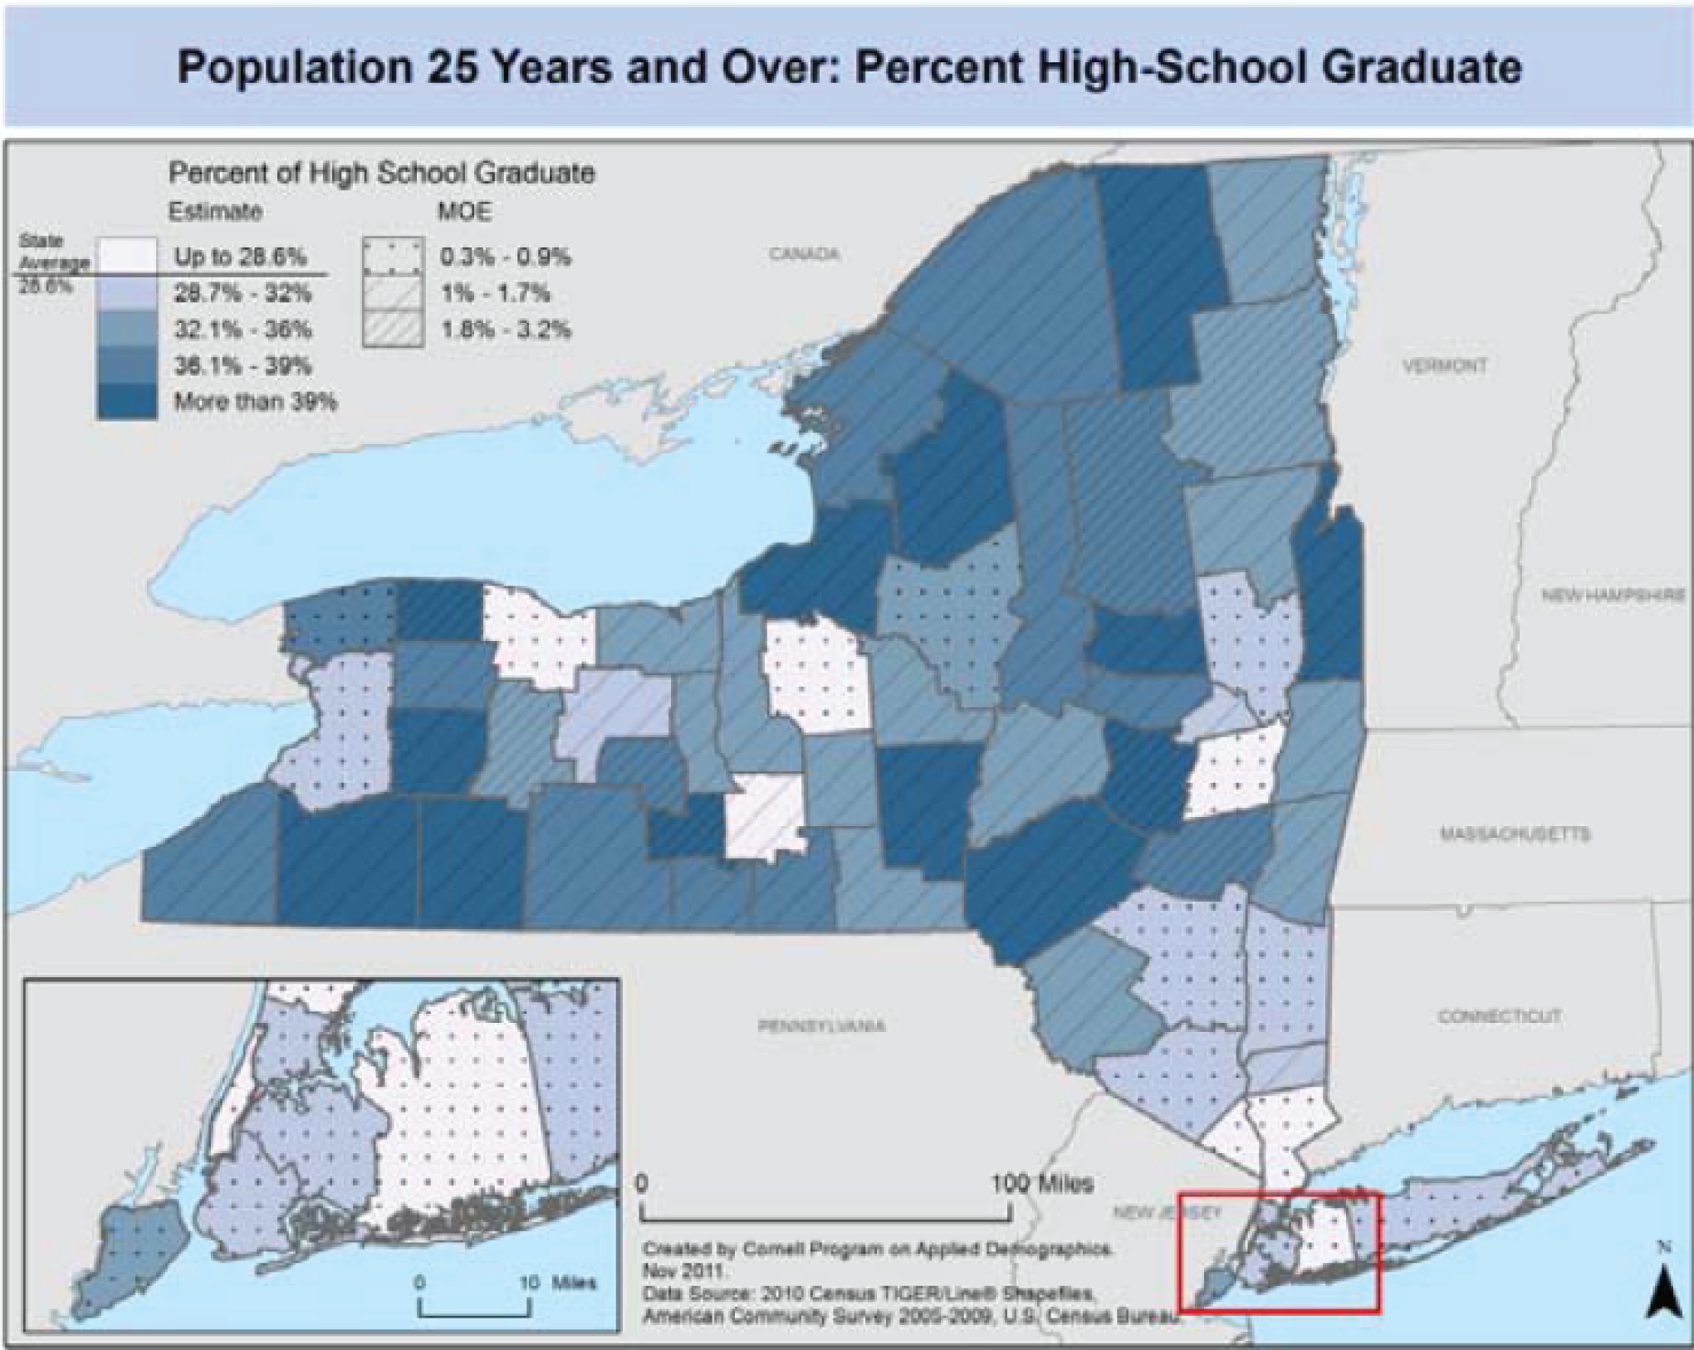
Researchers have produced several methods for mapping the margin of error.
Example map featuring reliability overlay
Source: Francis, J., Vink, J., Tontisirn, N., Anantsuksomsri, S., & Zhong, V. (2012). Alternative strategies for mapping ACS estimates
and error of estimation. Cornell University, Program on Applied Demographics
Notes:
Finally, the fourth option is to overlay some measurement of reliability on top of the data of interest. For example, as the margin of error increases, the overlay changes from thin to thicker cross-hatching. Similar to the drawbacks of the side-by-side maps, these maps with the overlay are difficult for users to quickly and easily understand.

Slide 8
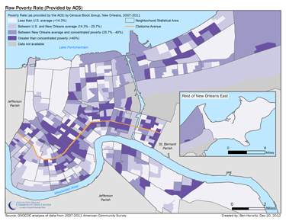
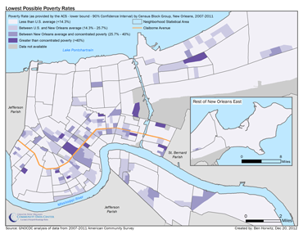
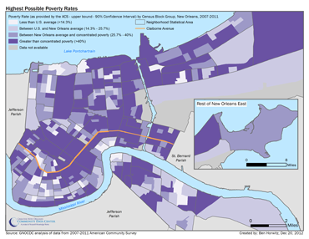
What does poverty look like in New Orleans as mapped by the ACS?
Notes:
The poverty rate map from the ACS did not “ground-truth.” For example, the Lower Ninth Ward we would expect to have higher poverty rates than the city. It is likely that the ACS block group values do not “ground-truth” because of the high margins of error depicted in the two maps showing the lower and upper bound of the ACS value.

Slide 9
We produced a series of methodology that might produce a more accurate map.
An average of all neighboring block groups.
An average of all “true” neighboring block groups (considering geographic boundaries like the Mississippi River).
Notes:
We produced a series of methodologies that might produce a more accurate map. The first and second method average the value of a particular block group with all of the neighboring or “touching” block groups assuming that neighboring block groups are more often than not, similar. The second uses our local knowledge to remove “neighbors” separated by geographic features like the Mississippi River.

Slide 10
We produced a series of methodology that might produce a more accurate map.
An average of all neighboring block groups.
An average of all “true” neighboring block groups (considering geographic boundaries like the Mississippi River).
A weighted average of the “true” neighbors with the weight applied evenly to all neighbors.
A weighted average of the “true” neighbors with the weight applied proportionally to all neighbors.
Notes:
The third and fourth methods employ a weighting methodology based on the number of respondents to the ACS. We evaluated the methods by comparing the 2010 Census count of household size by type to the ACS household size by type produced by each method. We chose the household size by type because it is a robust table of households values.

Slide 11
We found that averaging the “true” neighbors was the best approach.
Table 1: Index of dissimilarity evaluation results – Household type by household size
Source: Horwitz, B. (2012). Geographies of Poverty. The Data Center.
Notes:
To evaluate the methodologies, we calculated the index of dissimilarity and found that all of the methods do a good job of improving upon the ACS. However, method 2, the average of the true neighbors and method 3, a weighted approach, do the best. We then decided to use Method 2, the simpler of these two methods, as it is easier to convey to a lay audience.

Slide 12
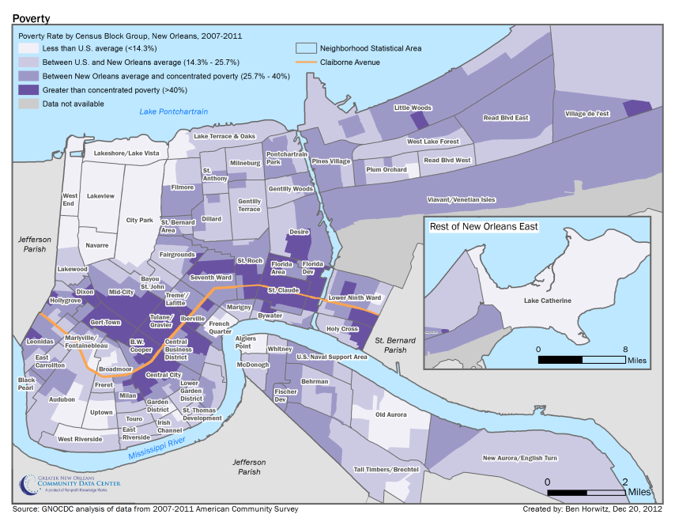
The averaging methodology produced a clearer picture of poverty in New Orleans.
Notes:
Another testament to the strength of the average methodology is that the estimated values fall within the confidence interval for 82 percent of the census block groups in New Orleans. Nonetheless, the results produced by the method are for mapping purposes only and we refer users to the actual ACS data and margins of error when necessary.

Slide 13
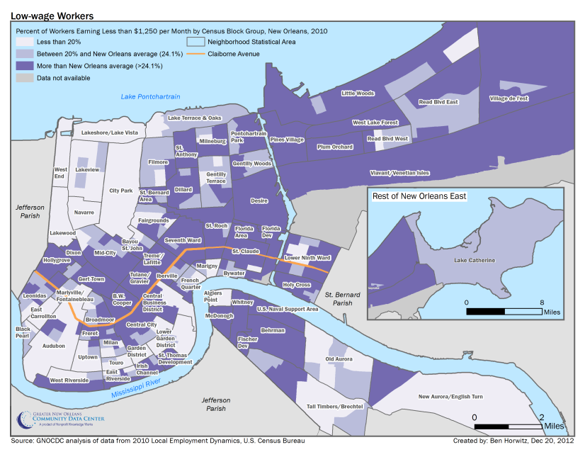
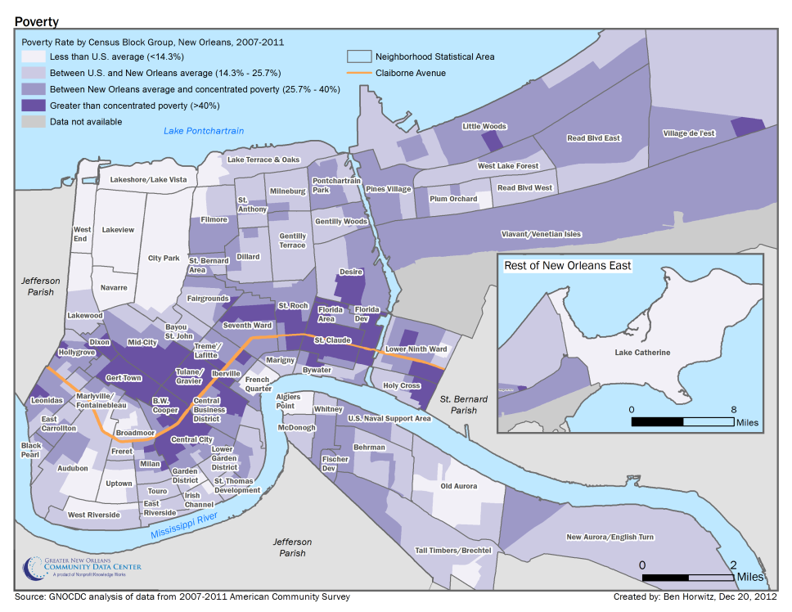
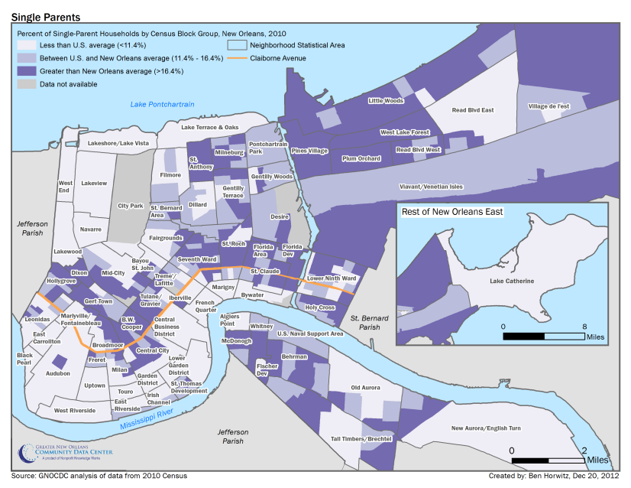
Comparing our ACS maps to LED or Census data helps “ground-truth” the results.
Notes:
Another way to evaluate the methodology is to compare the ACS produced maps to maps of administrative or census variables known to correlate with poverty such as low-wage workers from the LED or single-parent households from the Census. As you can see, the averaging method produces maps similar to the LED or Census variables.

Slide 14
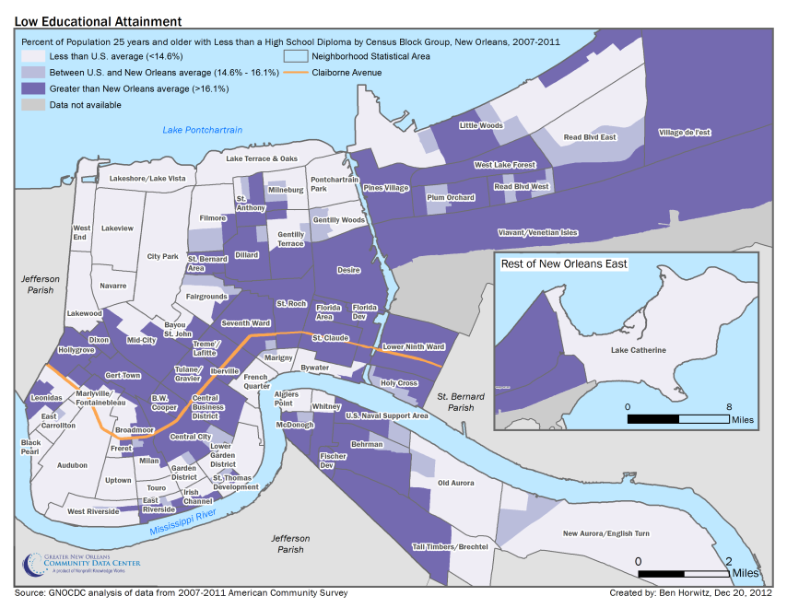
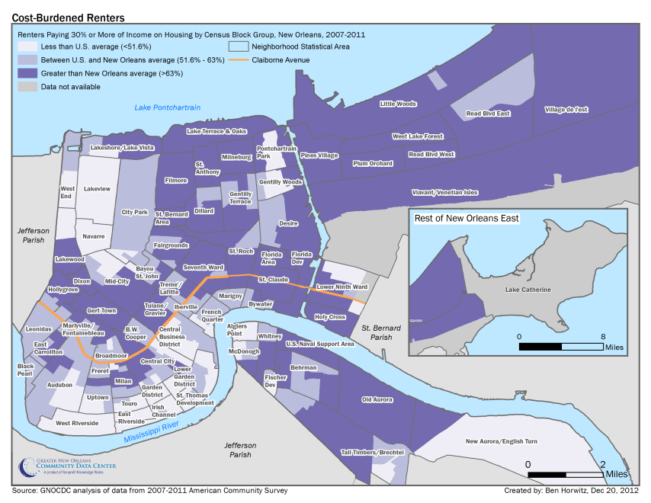
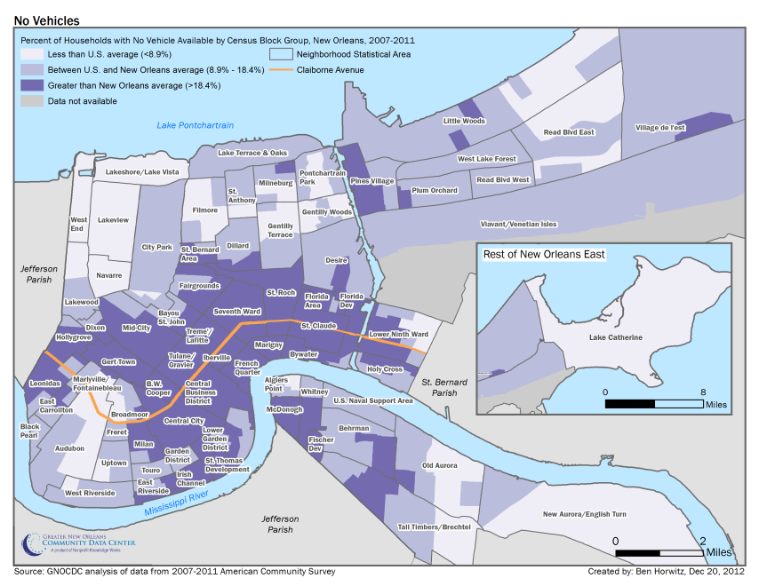
The geographies of poverty in New Orleans follow a consistent spatial pattern.
Notes:
The resulting maps ground truth with what we know about poverty in New Orleans and have been extremely well-received from the community as they also met their growing demand to map all sorts of variables related to poverty. Seeing so many variables related to poverty mapped conveyed that indeed, the geographies of poverty in New Orleans follow a consistent spatial pattern regardless of the indicator.

Slide 15
Geographies of Poverty:
Improving the reliability and usability of spatial displays of small area data from the American Community Survey
Presented by:
Ben Horwitz
April 2, 2014
Notes:
We believe it is essential that the margin of error be considered when using data from the ACS. However, this is difficult to execute spatially. Many existing methods are either insufficient or difficult for users to understand when examining neighborhood level data. We conclude that the best method for displaying ACS data spatially is an average of all “true” neighbors for each block group.

